Slide 1

Rethinking Memory Management in Modern Operating Systems
Group 16 – Weekend batch
SOS – IE2032

Slide 2



Group Members
IT23368248 S.M. Dissanayaka IT23406094 Jayasinghe S.d IT23381322 Rajapaksha R.P IT23265592 Rajapaksha R.M.P.U

Slide 3

Contents
1. Main problems & challenges
2. Proposed solutions
3. Methodology
4. Results & conclusion

Slide 4
Introduction
Referred Report :
Rethinking Memory Management in Modern Operating Systems published by IEEE
Challenges with Traditional Memory Management :
Traditional memory management focus on single-level horizontal partitioning.
Importance of Modern Memory Management:
Managing memory is crucial because there are multiple tasks running simultaneously in these systems.
Introduction of the HVR framework
combines horizontal, vertical partitioning and uses random-interleaved allocation.

Slide 5

Main Problem & Challenges

Slide 6
Challenges in Traditional Memory Management:
Resource contention, inter-program interference, and poor cache utilization.
Performance slowdown in multicore systems with complex workloads
HVR Framework: Three Techniques:
Horizontal Partitioning: Reduces competition by dividing data across the same memory level.
Vertical Partitioning: Optimizes performance across cache and DRAM
Random Allocation: Prevents memory hotspots and improves performance.

Slide 7
Test Results:
Tested on 2000+ workloads.
Implemented in Linux kernel with 21% performance improvement.
Finally,
Hvr is a flexible and dynamic approach for efficient resource use.
Improved performance

Slide 8

Proposed Solutions
According to the research paper that we chosen we able to come across 5 main approaches/solutions that can use for this by given the authors.
Vertical Partitioning Sys-Mon Partitioning & Coalescing Multi- policy framework Implementation in Linux kernel

Slide 9

Methodology

Slide 10
Inefficient memory Access Patterns
Vertical partitioning
Horizontal partitioning
Limited flexibility
HVR adapts by selecting the best memory management policies based on the application's characteristics, optimizing performance for various workloads.
Handling Dynamic Workloads
HVR continuously monitors applications' memory and cache behavior, dynamically adjusting memory allocation policies to maintain high performance as workloads evolve.

Slide 11
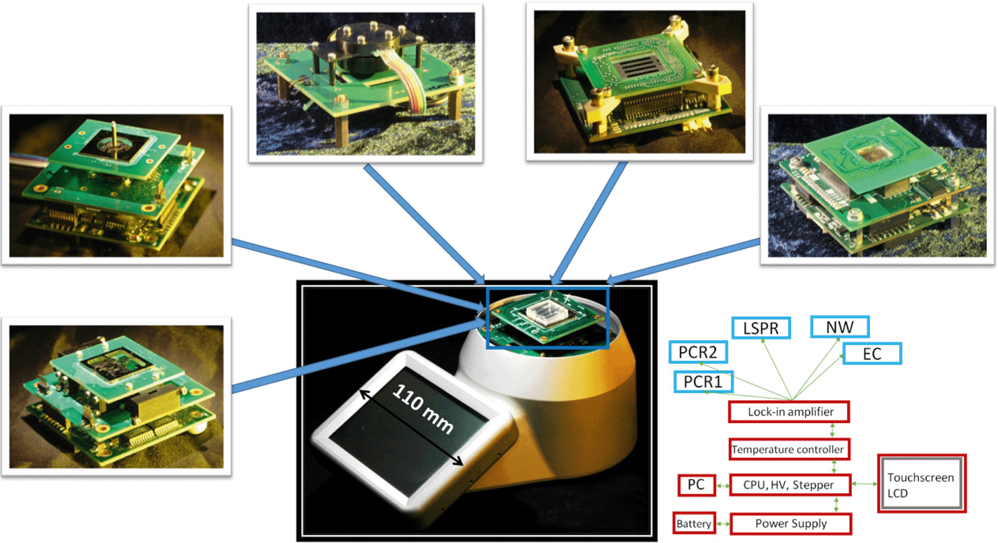
Managing Multiple applications
Uses data mining to create rules for resource partitioning and merging, ensuring efficient memory utilization and minimizing conflicts in multi-application environments.
Overhead in memory Management
Efficient Implementation
Curve-VP

Slide 12

Results & Conclusion

Slide 13

Results & Conclusion
Results : HVR Framework performance evaluation
Reduce overhead in HVR Framework
Page Table Sampling
Page Allocation and Indexing
Page Migrations
Performance
Adjust memory sharing to reduce performance loss
Dynamic partitioning reduce performance loss as following :
for small workloads - 0.01-0.03
for large workloads - 0.1-0.3

Slide 14


Real-World Implementation and Gains:
Successfully implemented in Linux kernel.
Maximize performance by up to 21%

Slide 15

conclusion

Slide 16

Conclusion
HVR provides efficient memory management
Real-world solution with multicore systems
Managing memory across multiple levels with randomized page allocation and vertical/horizontal partitioning.
HVR delivers up to 20% performance gains.
Can be used for cloud computing and where efficient memory management is crucial.
Major achievement in addressing memory conflicts and improving allocation in multicore system.

Slide 17

References

Slide 18

References
L. Liu, Y. Li, C. Ding, H. Yang, and C. Wu, “Rethinking Memory Management in Modern Operating System: Horizontal, Vertical or Random?,” IEEE Transactions on Computers, vol. 65, no. 6, pp. 1921–1935, Jun. 2016, doi: https://doi.org/10.1109/TC.2015.2462813

Slide 19


Slide 20


